Slide 1

How to Really Use
ChatGPT 4o
Free Version

Slide 2




Notes:
https://www.youtube.com/channel/UC35ZpwldGw7ZJ5R-2sLijzw

Slide 3
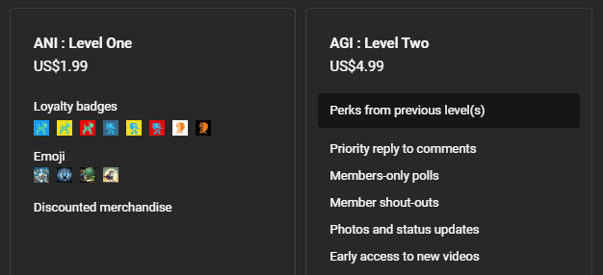

Membership has its privileges
Notes:
https://www.youtube.com/channel/UC35ZpwldGw7ZJ5R-2sLijzw/join

Slide 4
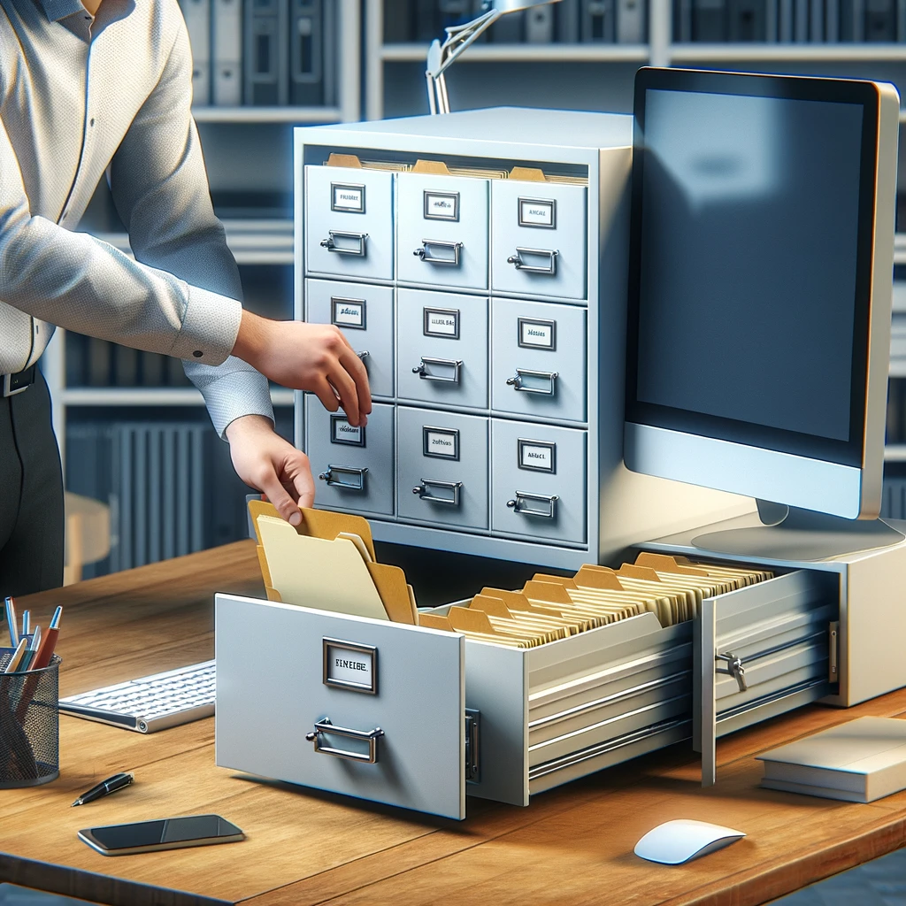
Working with files

Slide 5
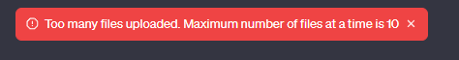
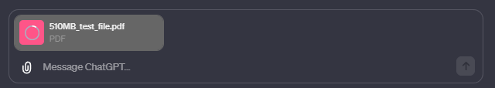
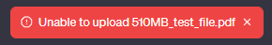
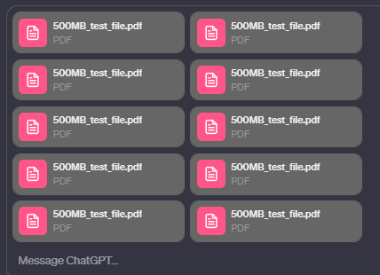
Document limitations
Up to 10 documents
500 MB per file
Documents are retained for three hours after the conversation is paused
Notes:
Generate a 500 mb pdf file that I can use for testing

Slide 6
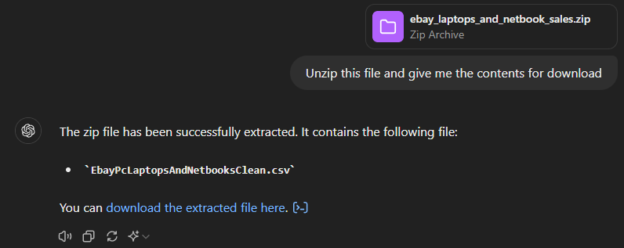
Zip files
Notes:
Unzip this file and give me the contents for download

Slide 7
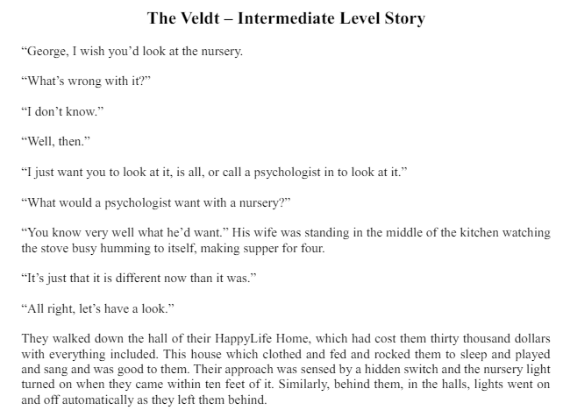
Document Analysis
Notes:
Give me a summary of this story in one paragraph and 5 key points
How many words are in this document?
How many times do the words "lion" or "lions" appear in this story? Give me the page number and sentence the word is in.

Slide 8
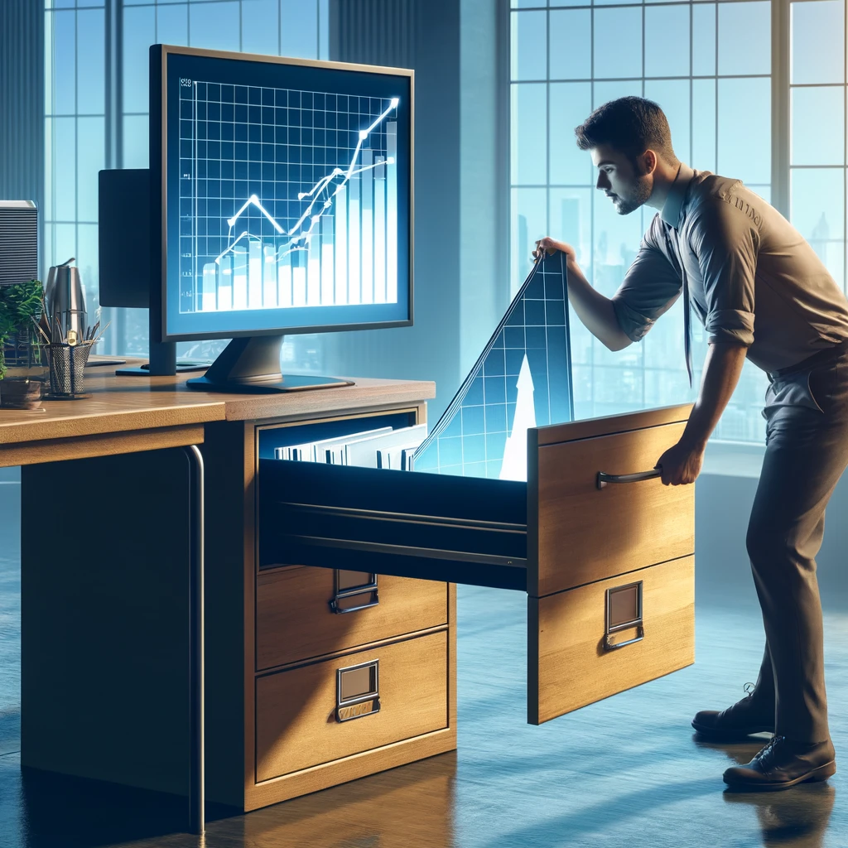
Data Analysis

Slide 9
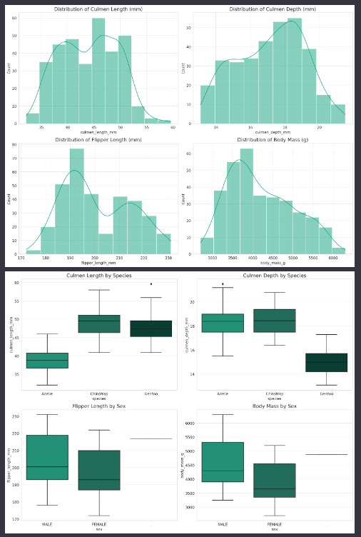
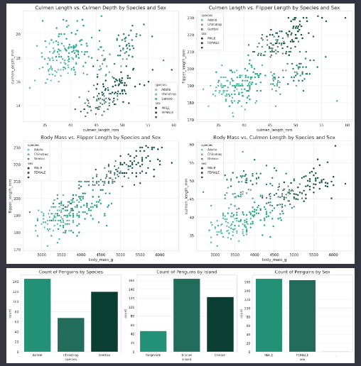
Data visualization
Notes:
https://www.kaggle.com/datasets
https://www.kaggle.com/datasets/parulpandey/palmer-archipelago-antarctica-penguin-data
Do a full clean and analysis of this data then give me all possible visualizations

Slide 10
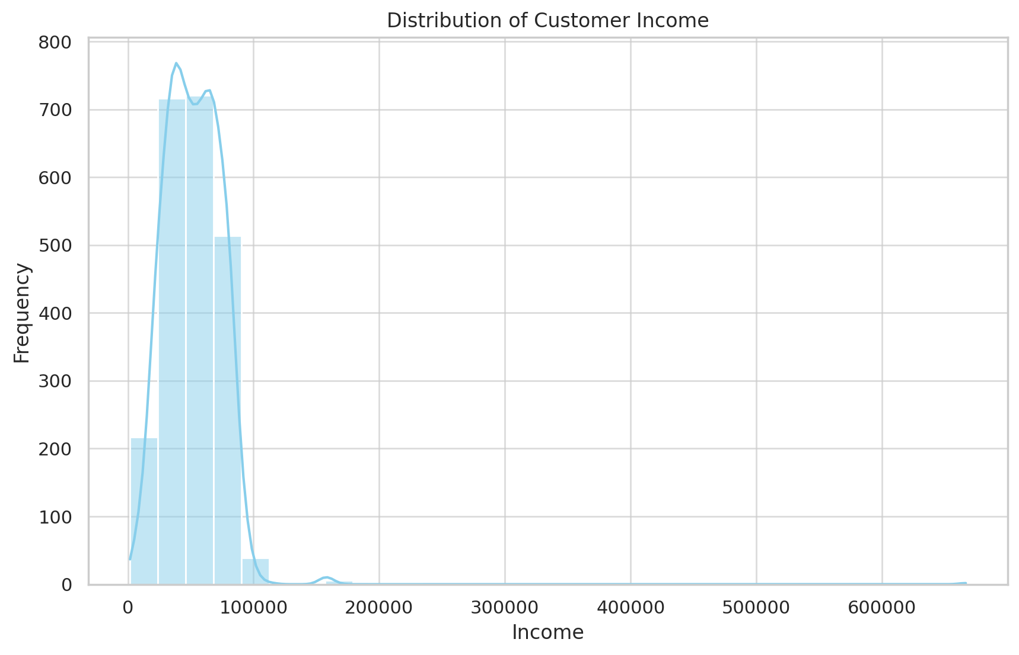
Analysis
Notes:
https://www.kaggle.com/datasets/elvinrustam/ebay-laptops-and-netbooks-sales
Unzip this and give me one paragraph on what this data is about and 3 impactful visualizations that represent the data. Make sure visualizations are presented individually.

Slide 11
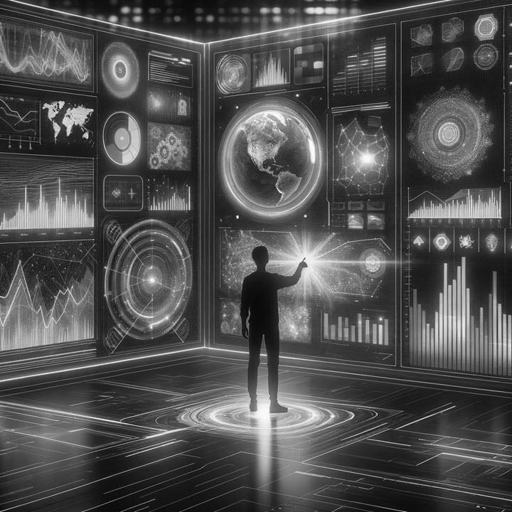
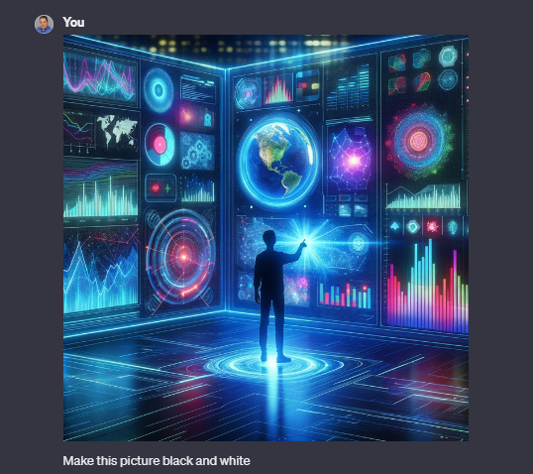
Image manipulation
Notes:
Make this picture black and white
Draw a square around the person in this picture

Slide 12
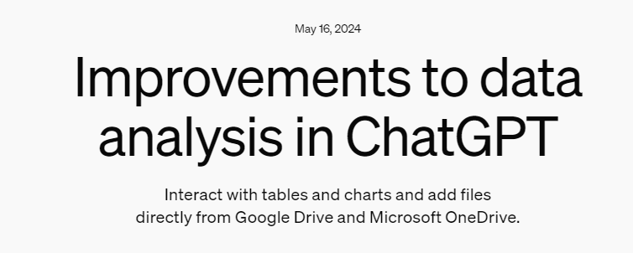
Notes:
https://openai.com/index/improvements-to-data-analysis-in-chatgpt/

Slide 13
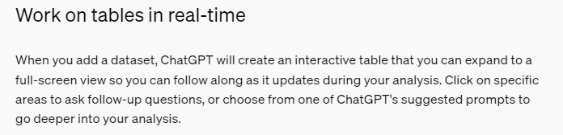

Slide 14
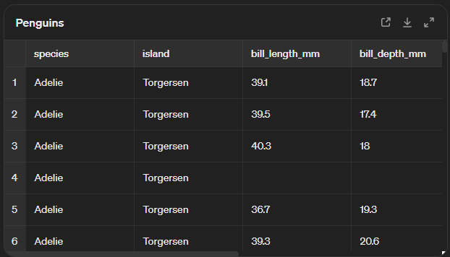
working on tables in real-time
Notes:
Add a column that shows the delta between body mass and average body mass for all penguins
Filter the data to only show penguins that are above the average body mass

Slide 15
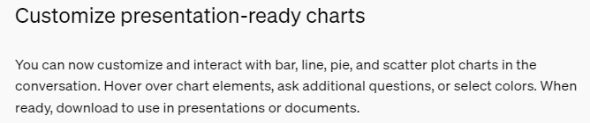

Slide 16
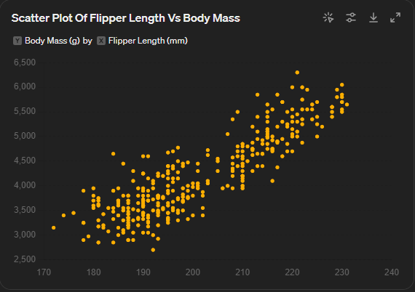
Customize charts
Notes:
Give me a scatterplot of flipper length to body mass
Color the dots by species
Show linear regression

Slide 17

Document creation

Slide 18
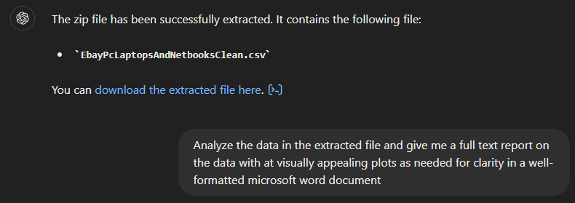
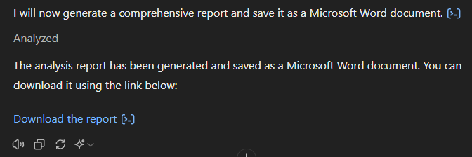
Just ask for the document
Notes:
You are an expert in data analysis and report generation. Analyze the data in the extracted file and give me a full text report on the data with at visually appealing plots as needed for clarity in a well-formatted microsoft word document. Make sure there are adequate margins and other items in place for a report that would be given to my boss. My career depends on this.

Slide 19


